Slide 1
Databases
Intro to APIs – Class 7

Slide 2

What is a Database?
A database is an organized collection of structured information, or data, typically stored electronically in a computer system.

Slide 3

What is a Database?

Slide 4

Types of Databases
Hierarchical databases
Network databases
Object-oriented databases
Relational databases
NoSQL databases
Flat-file databases

Slide 5
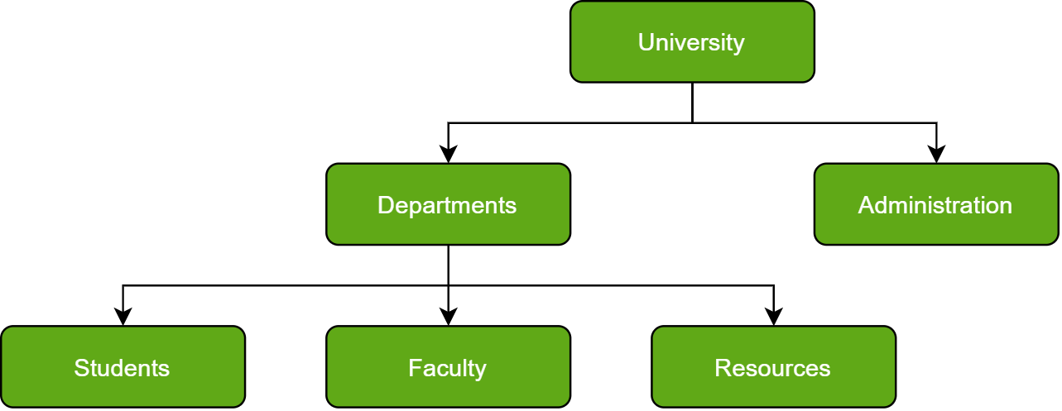
Hierarchical Databases
Just as in any hierarchy, this database follows the progression of data being categorized in ranks or levels, wherein data is categorized based on a common point of linkage. As a result, two entities of data will be lower in rank and the commonality would assume a higher rank.
Resembles a tree, due to parent-child relationships.
Not easily to go through; the addition of data elements requires a lengthy traversal through the database.

Slide 6
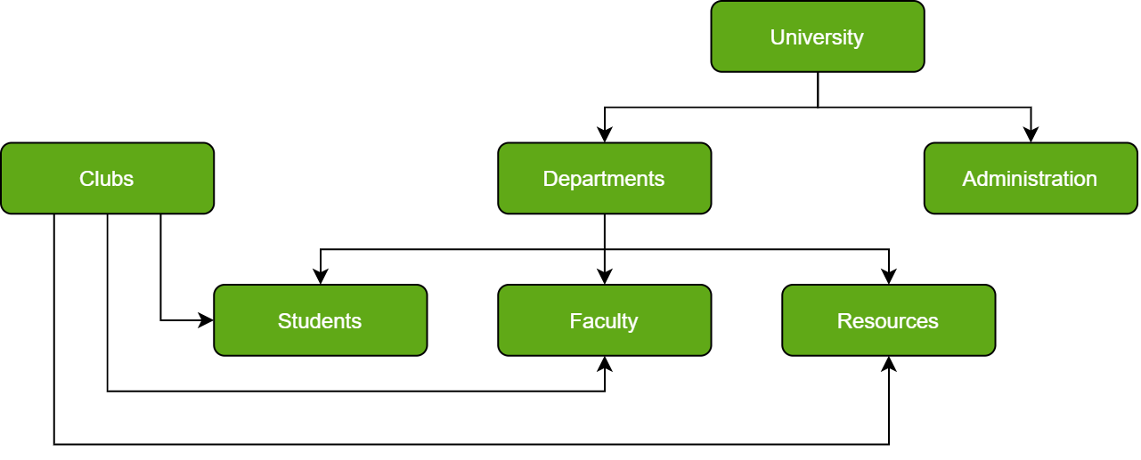
Network Databases
A network database is a hierarchical database… with a twist. Child records are given the freedom to associate with multiple parent records. As a result, a network or net of database files linked with multiple threads is observed.
More flexible in its ability to elegantly represent relationships.
Its disadvantage lies in the inability to alter the structure due to its complexity and in it being highly structurally dependent.

Slide 7
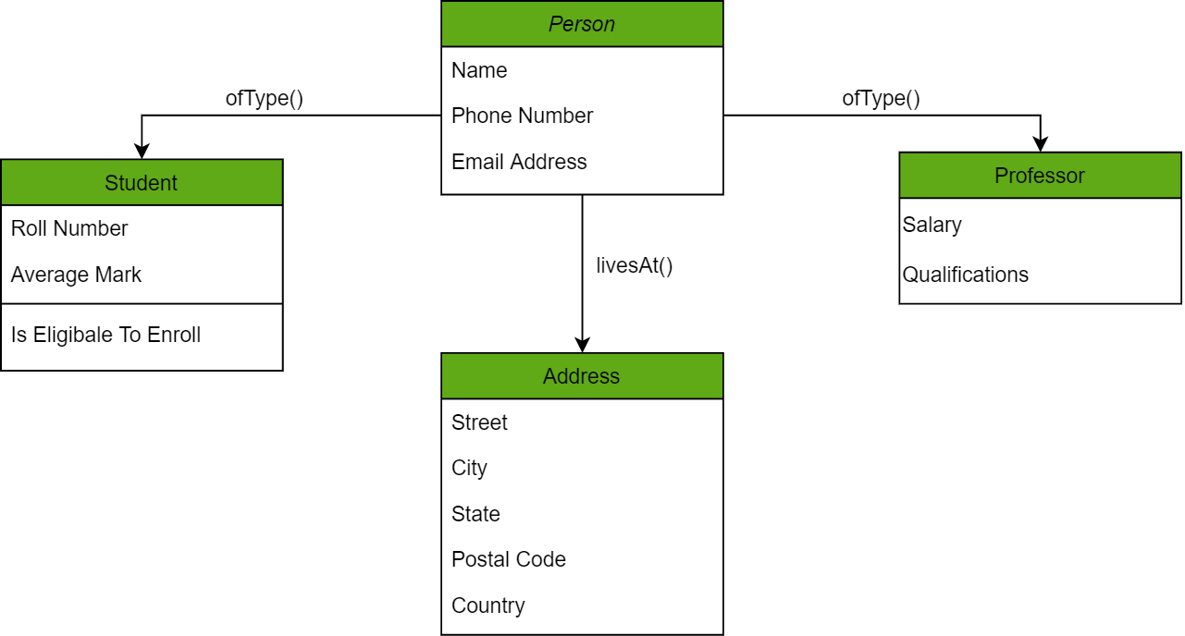
Object-Oriented Databases
Information stored in this type of database is capable of being represented as an object which responds as an instance of the database model. Therefore, the object can be referenced and called without any difficulty. As a result, the workload created by database queries / commands is substantially reduced.

Slide 8
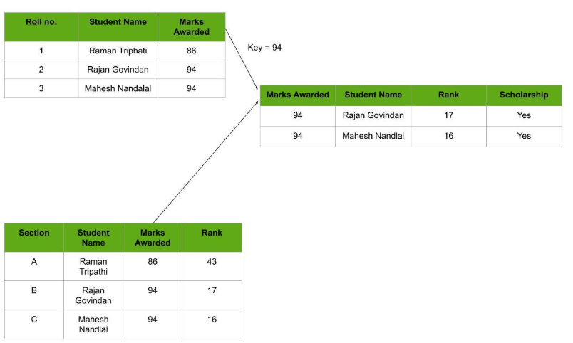
Relational Databases
Considered the most mature of all databases, these databases lead in the production line along with their management systems (like MySQL Workbench!)
In this database, every piece of information (column) has a relationship with every other piece of information. This is due to every data value in the database having a unique identity in the form of a record (row) that spans across different types of information (columns.)

Slide 9
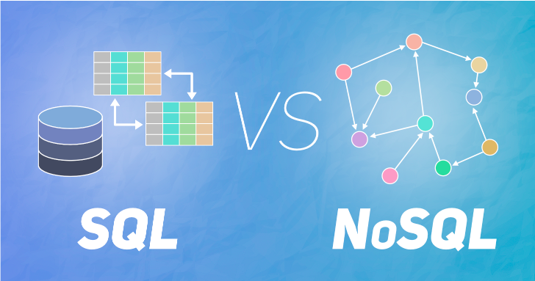
NoSQL Databases
Includes simplicity of design and finer control over availability. The data structures used by NoSQL databases are different from those used by default in relational databases which makes some operations faster in NoSQL. The suitability of a given NoSQL database depends on the problem it needs to solve. Data structures used by NoSQL databases are sometimes also viewed as more flexible than relational database tables.
There are many advantages of working with NoSQL databases such as MongoDB and Cassandra. The main advantages are high scalability and high availability.

Slide 10
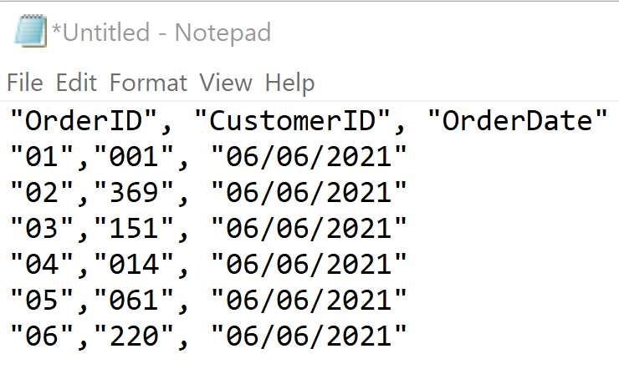
Flat-file Databases
A flat-file database is a database stored in a file called a flat file.
A flat file is a file that is not related to nor does it contain any linkages to any other file. It is generally used for stand-alone lists.
The file is simple. A flat file can be a plain text file (e.g. csv, txt or tsv), or even a binary file.
There are no structures for indexing or recognizing relationships between records.
Relationships can be inferred from the data in the database, but the database format itself does not make those relationships explicit.

Slide 11

MySQL is an open-source relational database management system (RDBMS).
Its name is a combination of "My", the name of co-founder Michael Widenius's daughter, and "SQL,” the most common language for extracting and organizing data that is stored in a relational database.
In addition to relational databases and SQL, a RDBMS like MySQL works with an operating system to implement a relational database in a computer's storage system, manages users, allows for network access, facilitates the creation of backups, and more.
Because MySQL enjoys the most widespread use in many industries, business users from new webmasters to experienced managers should strive to understand its main characteristics. Deciding whether to use this technology, and communicating about it effectively, starts with a review of MySQL’s basic availability, structure, philosophy, and usability.

Slide 12
MySQL is widely compatible.
Though often associated with internet applications or web services, MySQL was designed to be extensively compatible with other technologies and architectures. This RDBMS runs on all major computing platforms, including Unix-based operating systems, such as the myriad Linux distributions or Mac OS, and Windows.
MySQL’s client-server architecture means it can support a variety of backends, as well as different programming interfaces.
MySQL is easy to use.
MySQL makes many concessions to supporting the widest possible variety of data structures. Beyond data types and an expansive built-in feature set, the MySQL ecosystem also includes a variety of tools, easing everything from server management to reporting and data analysis.
Regardless of the RDBMS’s overarching architecture, users can invariably find a MySQL feature allowing them to model and codify data how they wish. MySQL remains one of the most straightforward database technologies to learn and use.

Slide 13

MySQL Server
MySQL Server can host multiple databases and process queries on those databases.
Once you have the MySQL Server installed, you can connect to it using any client program such as MySQL Command-Line Client or MySQL Workbench.

Slide 14

MySQL Workbench
MySQL Workbench provides a GUI for working with MySQL Servers and databases.
It is a visual database design tool that integrates SQL development, administration, database design, creation and maintenance into a single integrated development environment for the MySQL database system.

Slide 15

MySQL Workbench: Tutorial
* Be sure to have your MySQL Server up and running before you follow this tutorial!

Slide 16
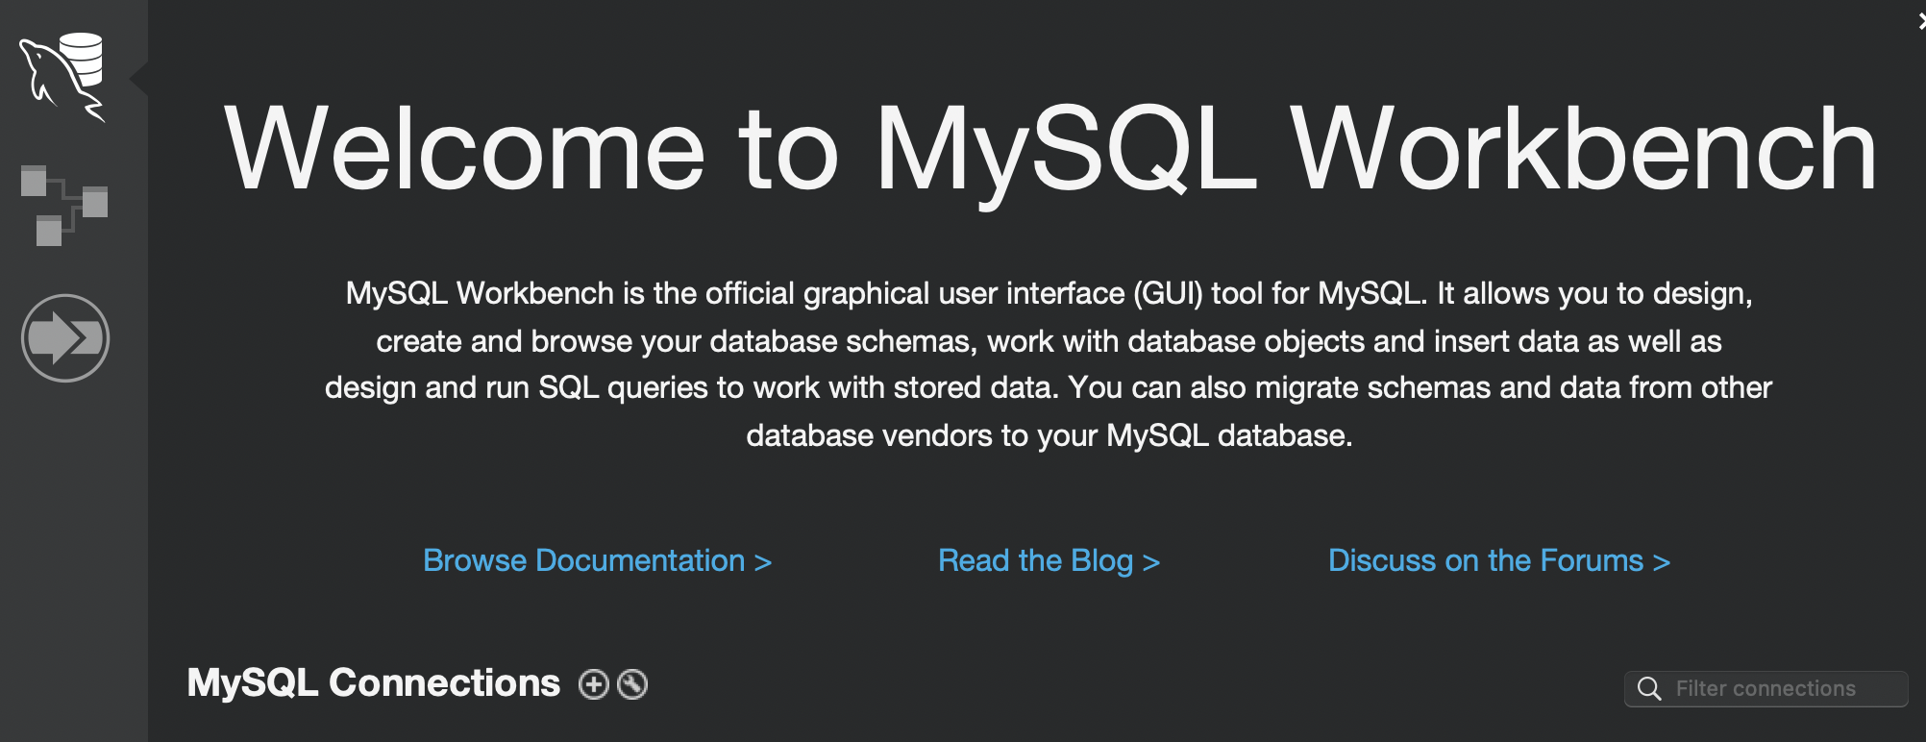
To add a connection to the MySQL Server, click the [+] icon to the right of the MySQL Connections title on the home screen. This opens the Setup New Connection form.

Slide 17
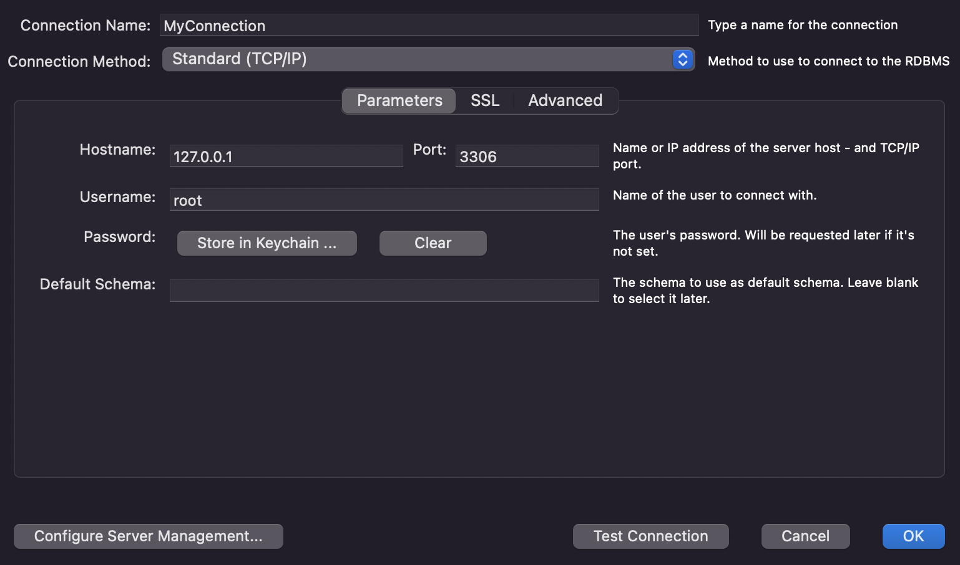
Define the Connection Name value, such as MyConnection.
Note the connection method! These are the default connection values are for a typical local setup, so we’ll leave them as they are, because that’s what we want.
Use the Store in Keychain option and store a password for root (the username we are using for this connection).
Click the Test Connection button to check the connection parameters. If things are looking good, hit OK.
* A schema is a collection of tables. It is considered the “blueprint” of a database which describes how the data may relate to other tables or other data models.

Slide 18
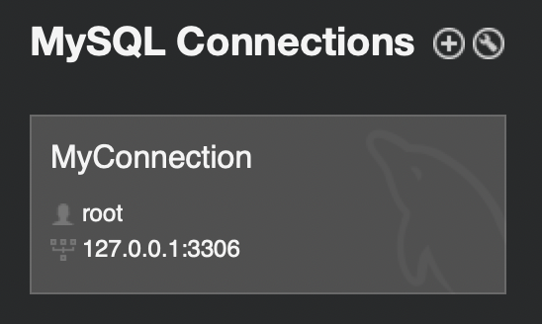
Woohoo, you now have a connection to your local MySQL Server set up! Click on it to get started.

Slide 19
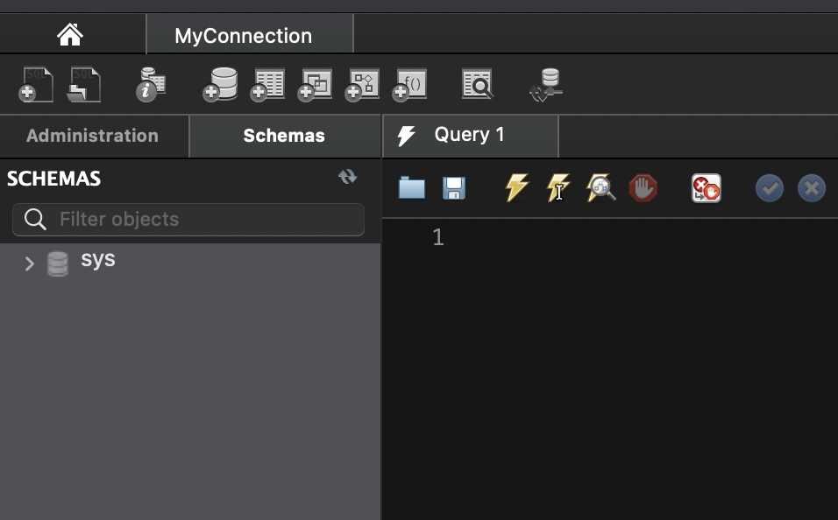
Make sure you’re on the Schemas tab! Once there, you should be able to see the sys schema.
All schemas contain a collection of views, procedures, and functions to assist MySQL database administrators in obtaining deeper information about their database more easily.
A view is a composition of a table in the form of a predefined SQL query. It has been defined as a virtual table of sorts.
A procedure is a subroutine (like a subprogram) in a regular scripting language, stored in a database.
A function is a stored program that you can pass parameters into and then return a value.

Slide 20
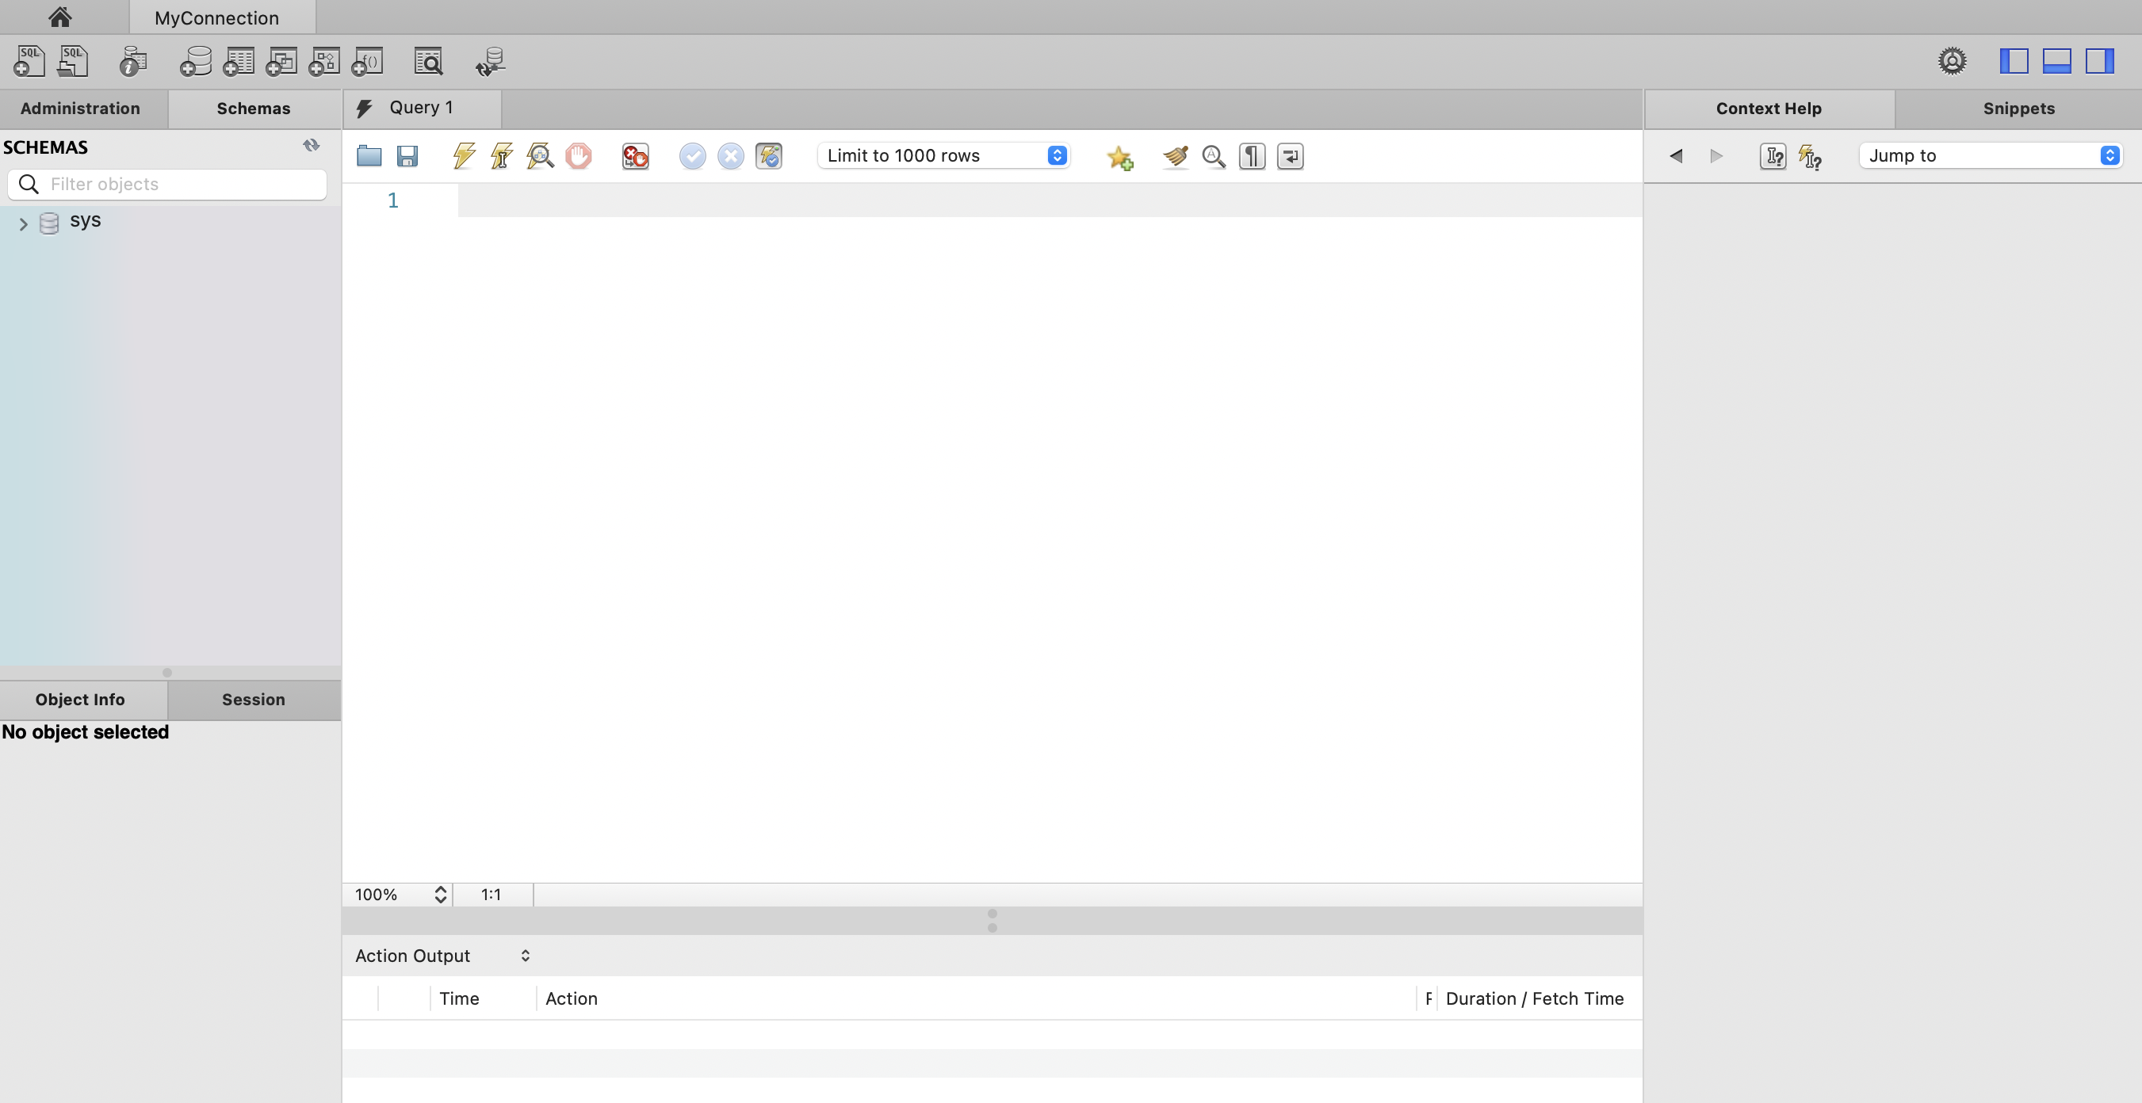
SQL editor: This is where you create and edit queries.
Help panel: You can view the syntax and description for a particular keyword here.
When you enter SQL code into the SQL editor, you can use the Save SQL to Snippets List toolbar button to save your SQL code– these named snippets can be viewed from the SQL Snippets Tab.
Navigation panel: This lets you manage your active MySQL connections and also shows the schemas on that server for a connection.
History output window: This displays a summary of the executed queries in the following forms: Action Output, Text Output, or History Output.

Slide 21
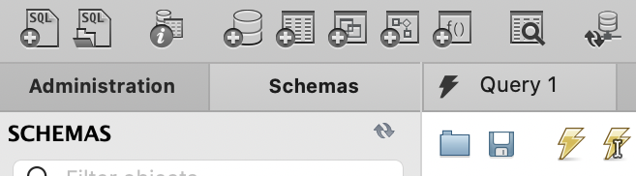
Create a new table in the active schema in the connected server.
Search table data for text in objects selected in the sidebar schema tree (navigation panel).
Create a new SQL tab for executing queries.
Open an Inspector view for the selected object.
Open a SQL script file in a new query tab.
Create a new schema in the connected server.
Create a new view, stored procedure, and function (left to right) respectively in the active schema in the connected server.
Reconnect to DBMS (database management service)– so, your server.

Slide 22
Execute the selected portion (or everything, if nothing is selected), execute the statement under the keyboard cursor, and execute the EXAPLAIN command on the statement under the cursor (left to right) respectively.
COMMIT the current transaction, ROLLBACK the current transaction, and toggle autocommit mode (left to right) respectively.
Beautify/format the SQL script, show the Find panel for the SQL editor, toggle the display of invisible characters (spaces, tabs), toggle wrapping for long lines (left to right) respectively.
Open a script file in this editor.
Set the limit for number of rows returned by queries.
Toggle whether execution of a SQL script should continue after failed statements.
A COMMIT means that the changes made in the current transaction are made permanent and become visible to other sessions. A ROLLBACK statement, on the other hand, cancels all modifications made by the current transaction.
By default, MySQL starts the session for each new connection with autocommit enabled, so MySQL does a COMMIT after each SQL statement if that statement did not return an error.
Save the current statement or selection to the snippet list.
Save this script to a file.
Stop the query being executed.
The EXPLAIN statement provides information about how MySQL executes statements.
When EXPLAIN is written in front of with an explainable statement (SELECT, DELETE, INSERT, REPLACE, or UPDATE), MySQL explains how it would process the statement, including information about how tables are joined and in which order.

Slide 23

(As seen when hovering over a schema or table in the navigation panel...)
Pulls up information about this table (or schema.)
Pulls up a quick editing tab for this table (or schema.)
For tables only; runs a quick SELECT * FROM on this table.

Slide 24
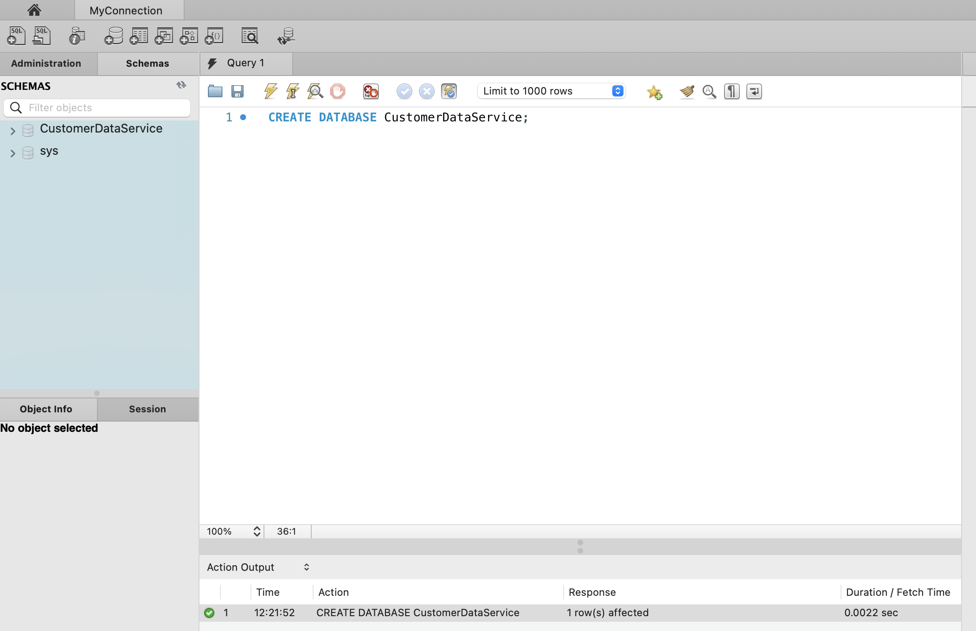
Create your first database! You might have to hit the refresh button to see changes in your navigation panel after you execute.

Slide 25
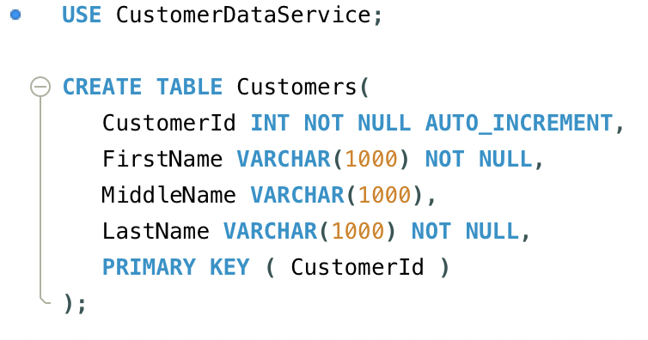
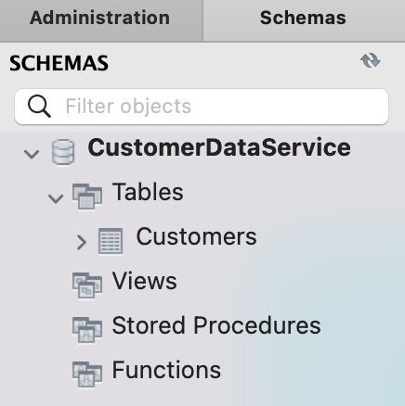
We need to make sure we set our active schema before we do any work on it.
Let’s create a basic Customers table!

Slide 26
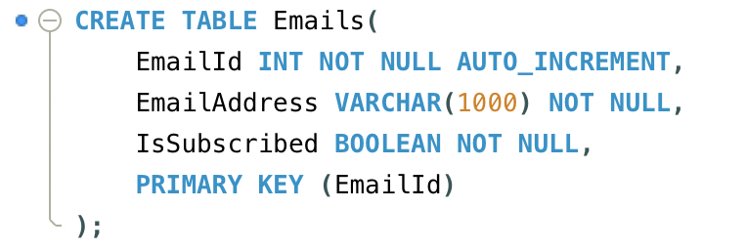
Now we’ll create an Emails table!

Slide 27
Next, we’ll add this column to the Customers table.

Slide 28
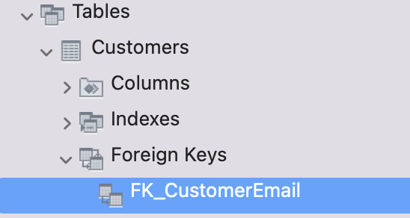
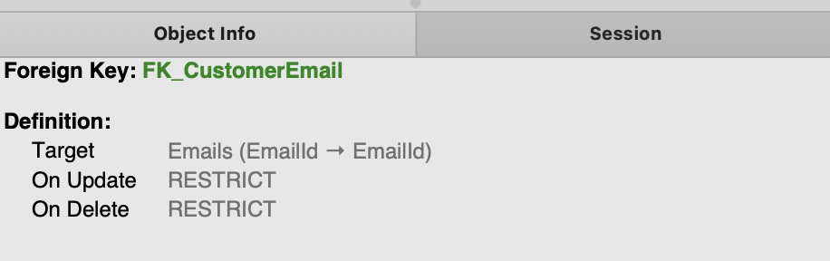
Now, we use the newest Customers column to make a foreign key to the Emails table.

Slide 29
Next, we use the newest Customers column to make a foreign key to the Emails table.

Slide 30
Let’s add a row to the Emails table!

Slide 31
Now, we add a row to the Customers table that has a foreign key to the Emails table.

Slide 32
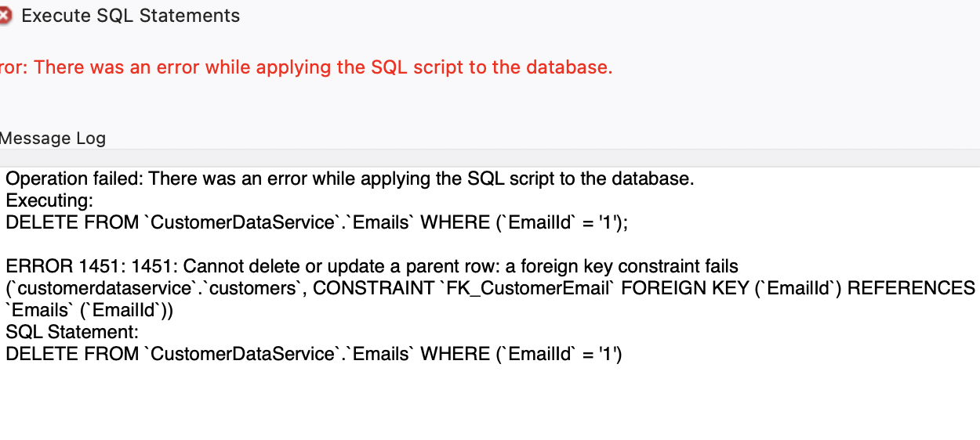
Note that you can’t delete our Email record now.

Slide 33

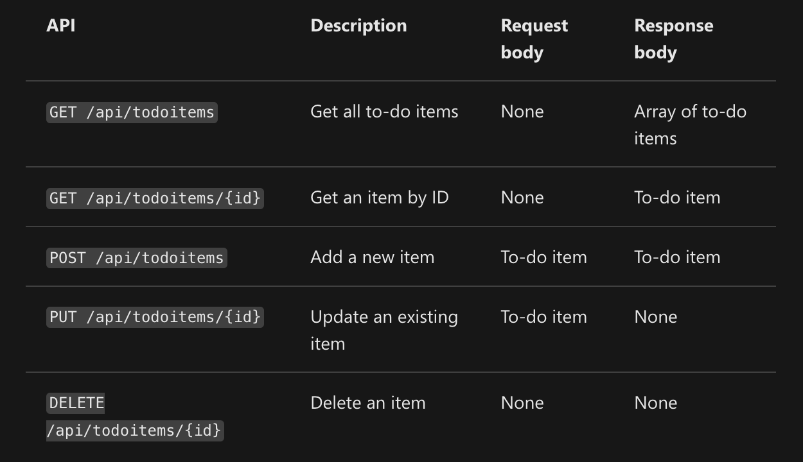
API Idea Presentations
* Due at 11:45PM the night before the first day of presentations!
You will be presenting your API concept to the class!
Your presentation should be 3-5 minutes long.
Your API idea should include:
What made you decide upon your idea for the API / what inspired you. (You can be transparent and say you found an example online if that’s the case!)
A diagram of your database, with…
At least two tables, two primary keys (one in each table), one foreign key, and one constraint. (I suggest that you try it on your own in MySQL Workbench, to make sure everything works!)
At least 3 different API endpoints, and explanations of those endpoints.
This is a valid description of some example endpoints.
What SQL command(s) would these endpoints run, in theory?
Be sure that all tables are being altered by at least one API endpoint.

